Slide 1
Hotel Restaurant Reservation System
BATCH:34
TEAM MEMBERS : S.PARDHU(2520090043)
S.VENUGOPAL(2520090185)

Slide 2
Abstract:-
A Hotel Restaurant Reservation System is a web-based or mobile application designed to simplify and automate the process of booking tables in a hotel restaurant. The system allows customers to check availability, select date and time, choose seating preferences, and confirm reservations online, reducing manual effort and waiting time. It provides a user-friendly interface for customers and an efficient management panel for administrators.
The system maintains a centralized database to store customer details, reservation records, and table availability, ensuring accurate and real-time updates. It improves operational efficiency, enhances customer satisfaction, and minimizes booking conflicts. Overall, this system offers a smart, reliable, and time-saving solution for both customers and hotel management.

Slide 3
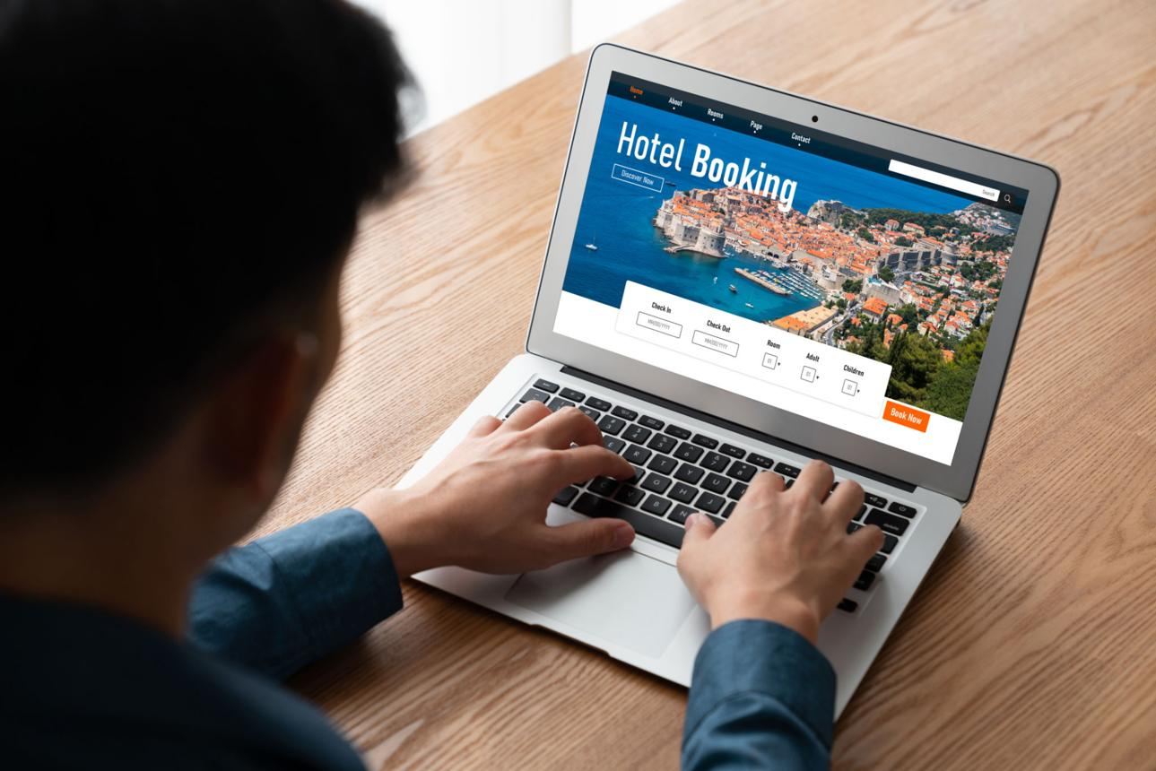
Purpose:-
The purpose of this project is to provide an online platform for customers to reserve hotel rooms and restaurant tables easily. It helps customers check availability, make bookings, and receive confirmations without visiting the hotel physically.

Slide 4
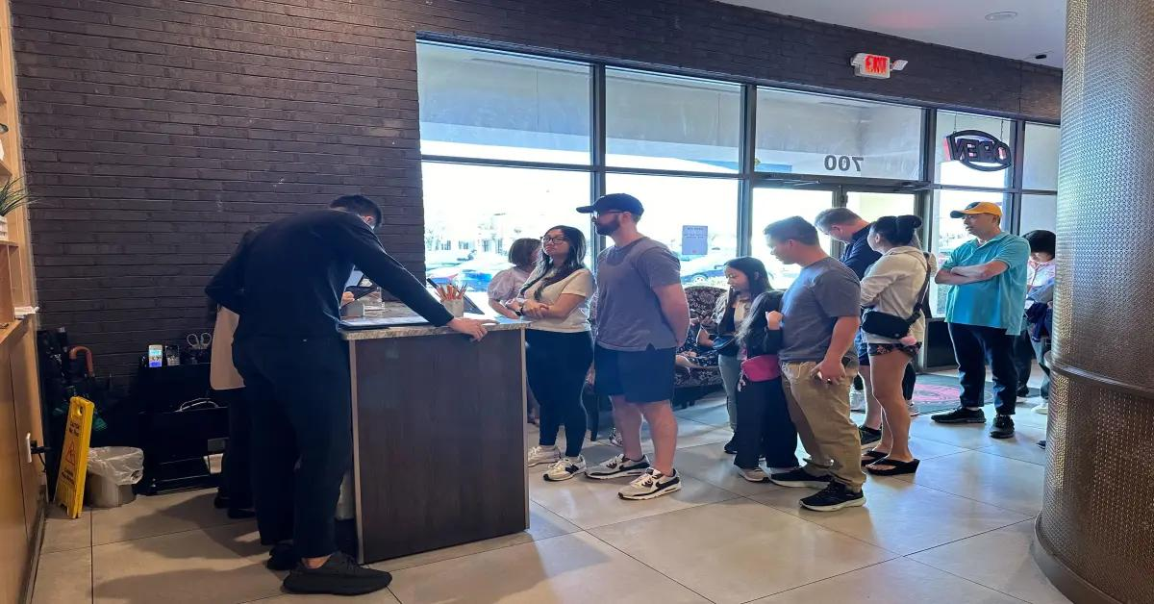
Problem Statement :-
Manual reservation systems often lead to booking errors, long waiting times, reservation conflicts, and inefficient record management. Customers cannot easily check real-time availability, and staff face difficulties in managing reservations. An automated system is required to improve efficiency and accuracy.

Slide 5
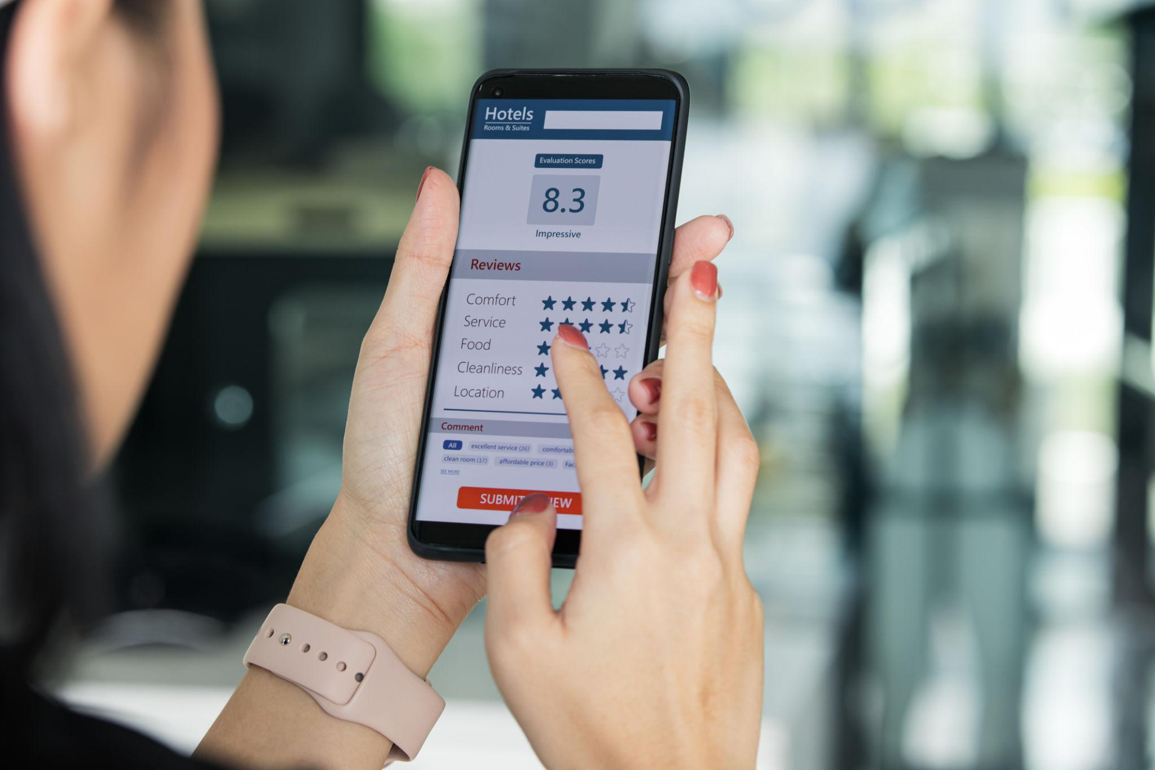
Goals:-
Provide online hotel and restaurant reservation facilities.
Display real-time availability of rooms and tables.
Reduce manual work and booking conflicts.
Improve customer satisfaction.
Maintain reservation records securely.

Slide 6
Scope:-
In Scope:-
User registration and login.
Hotel room booking.
Restaurant table reservation.
Availability checking.
Booking confirmation and cancellation.
Reservation management for administrators.
.
Out of Scope:-
Online payment gateway integration.
Third-party travel services.
Delivery services.
Advanced AI recommendation systems

Slide 7
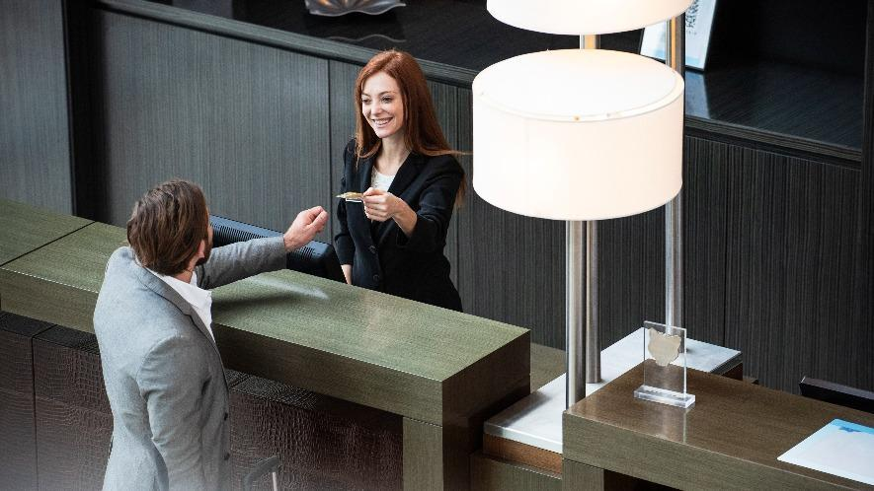
Functional Requirements:-
User Registration and Login.
Search Hotels and Restaurants.
Check Room/Table Availability.
Make Reservations.
View Booking Details.
Cancel Reservations.
Manage Customer Records.
Admin Dashboard for Reservation Management.
Real-time Availability Updates.
Users:-
Customers/Guests
Hotel Management
Restaurant Staff
System Administrator

Slide 8
Non-Functional Requirements:-
User-friendly Interface.
Fast Response Time.
Secure Data Storage.
Reliability and Availability.
Scalability.
Cross-Platform Compatibility.
Data Privacy and Security.
Assumptions:-
Users have internet access.
Hotel and restaurant details are updated regularly.
Customers provide valid information during registration.
The system database remains operational.
Administrators manage reservation records properly.

Slide 9
Acceptance Criteria:-
Users can successfully register and log in.
Customers can book hotel rooms and restaurant tables.
Real-time availability is displayed correctly.
Booking confirmation is generated successfully.
Reservations are stored and managed without errors.
Admin can view and manage all reservations.
System operates smoothly without booking conflicts.

Slide 10
*THANK YOU*

